Slide 1
SPECIAL USE PERMIT CASE NUMBER WSUP19-0019
(Mustang Industrial Development Grading)
Washoe County Board of Adjustment
December 5, 2019

Slide 2
Request
Modify the design of previous grading (SB15-001), the grading has already been done.
Cut slope, up to 30 feet in height, with a slope of 1 horizontal to 1 vertical (1:1) and a length of approximately 900 feet, in a location that was previously approved to be stabilized by terraced retaining walls
Rip-rap slope, up to approximately 25 feet in height, with a slope of approximately 2 horizontal to 1 vertical (2:1) and a length of approximately 120 feet, in an area that was previously approved to be stabilized by a slope of 3 horizontal to 1 vertical (3:1)
Provide for the mitigation of rock stockpile areas by revegetation.
Varying the allowable height of slopes, steepness of slopes and use of rip-rap for stabilization of slopes is requested.

Slide 3
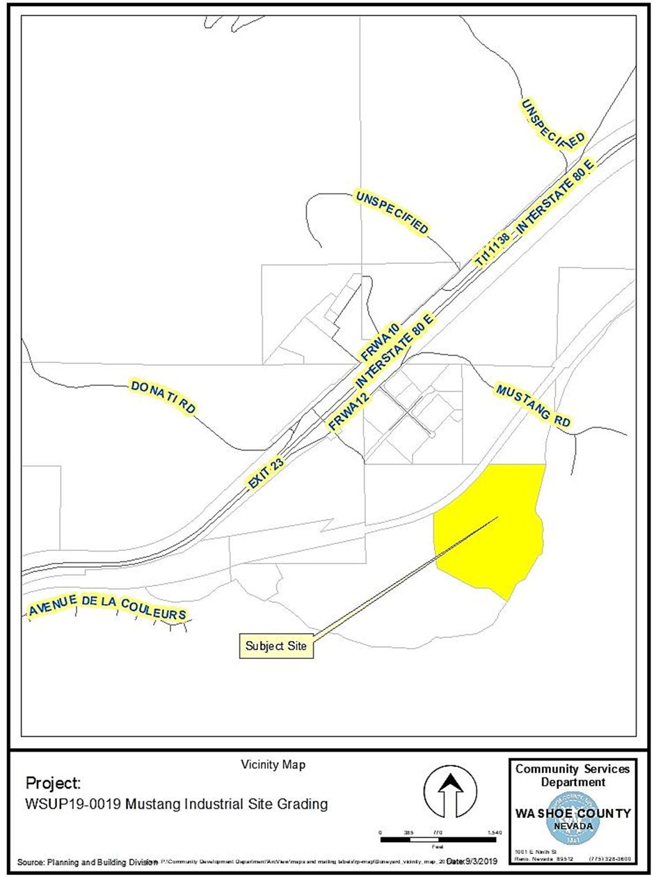
Location

Slide 4
Overview
Three areas of difference
Cut Slope
Rip-rap slope
Rock Piles

Slide 5
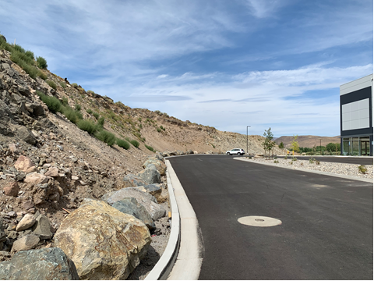
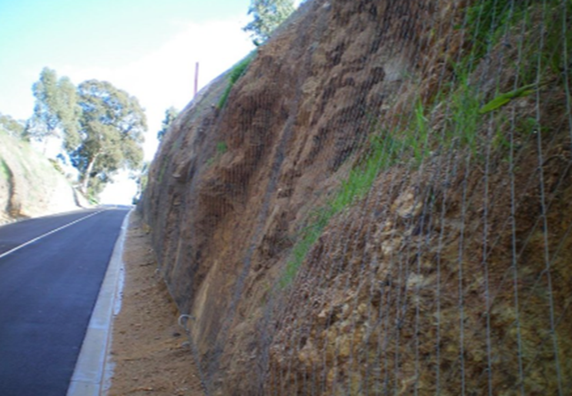
Overview – Cut Slope
Approved with retaining walls.
Proposed to be stabilized with wire mesh.
Current Condition
Example of Proposed Condition

Slide 6
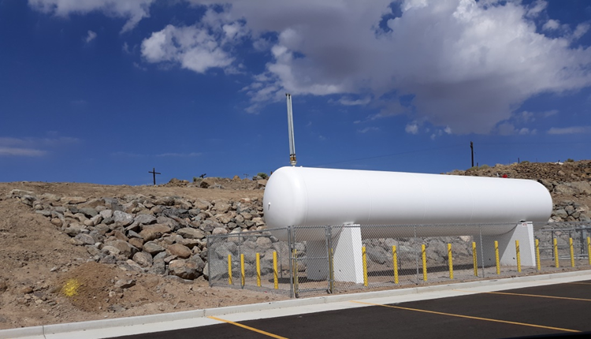
Overview – Rip-Rap Slope
Approved with 3:1 slopes and revegetation
Built with rip-rap at 2:1 slope.
To be treated with rock stain
Current Condition , Proposed To Remain

Slide 7
Overview – Rock Piles
Approved with no disturbance in this area
Proposed to be mitigated
  Returned to a natural-appearing contour
  Soil added over / around rocks
  Soil revegetated
  Some boulders to remain exposed

Slide 8
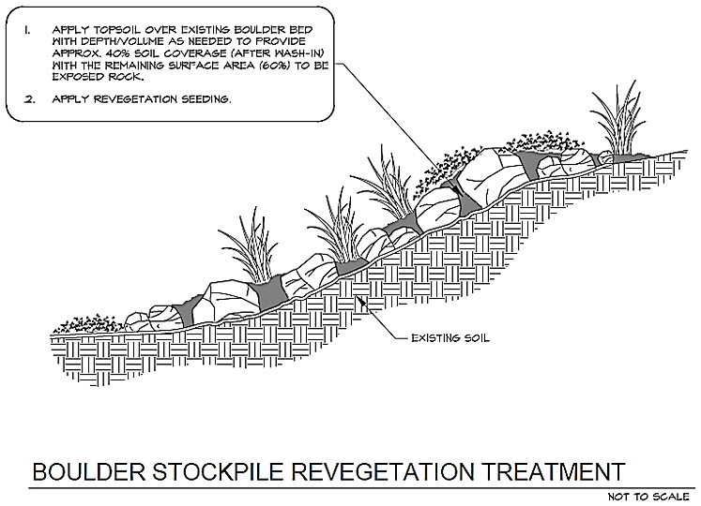
Overview – Rock Piles
Proposed treatment of rock pile areas

Slide 9
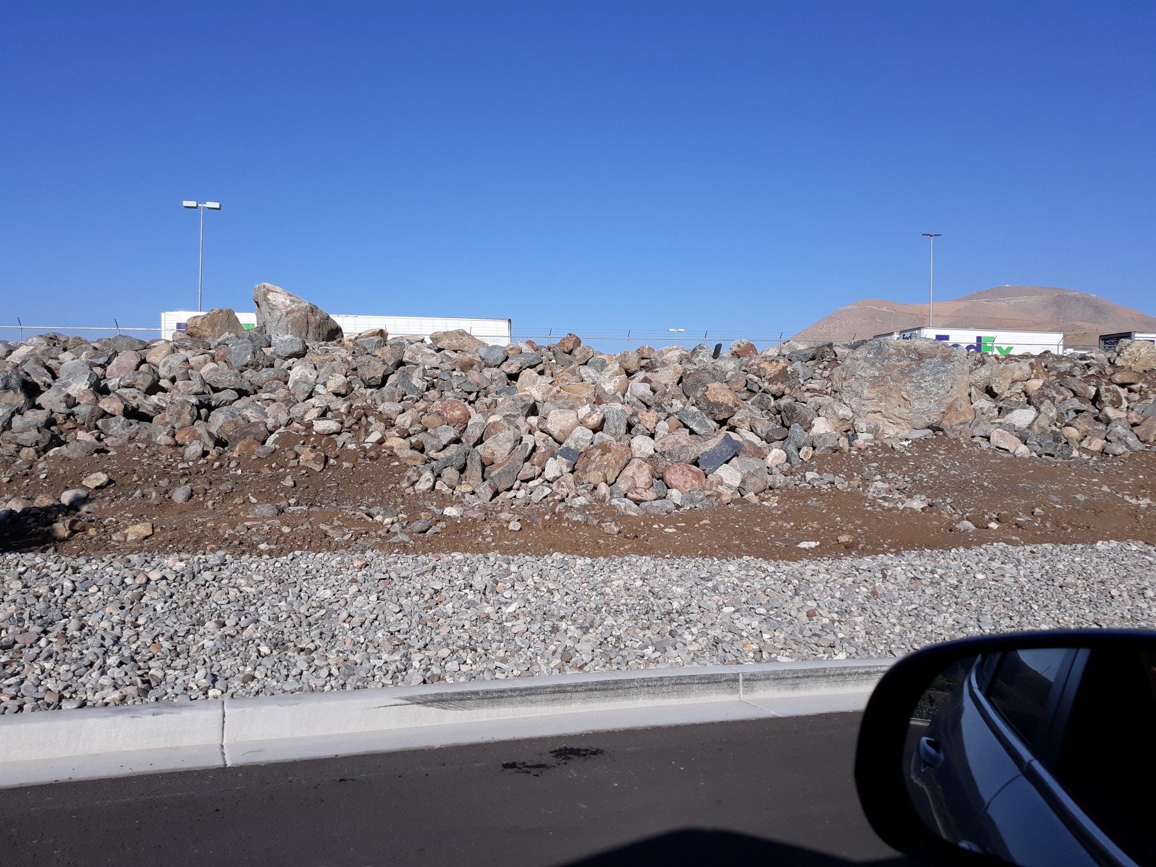
Rock Piles, Existing Condition

Slide 10
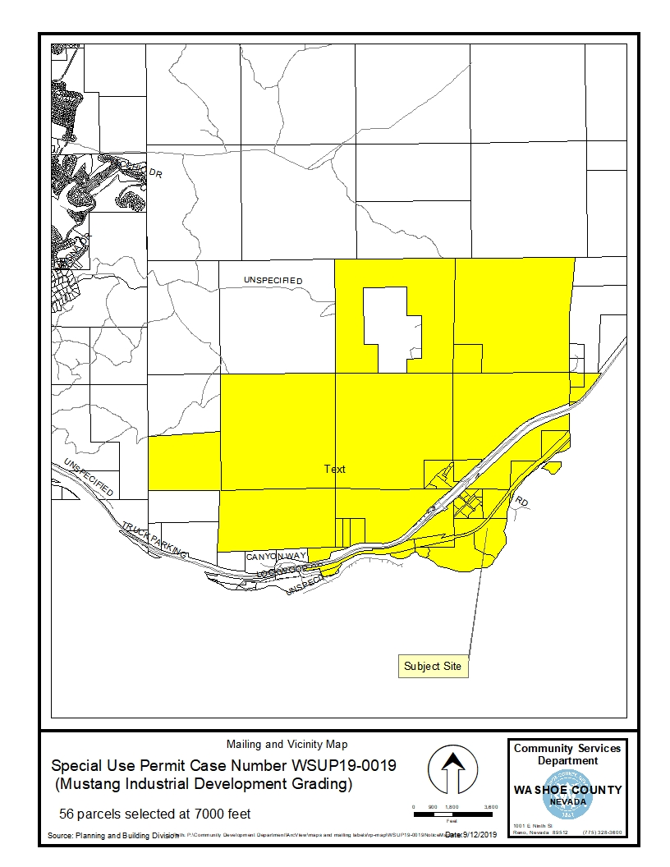
Public Notice & CAB
Notice sent to 56 affected property owners
No CAB meeting during the review for this permit. No individual comments received.

Slide 11
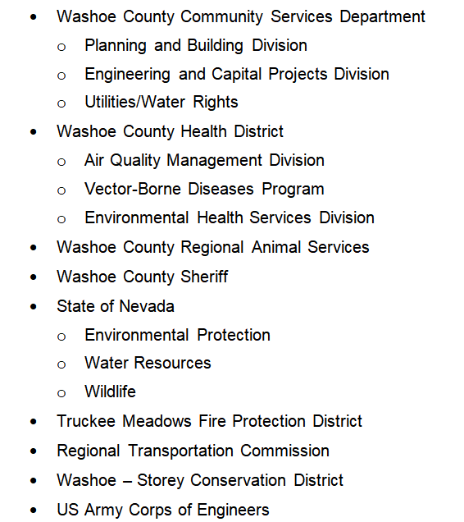
Reviewing Agencies

Slide 12
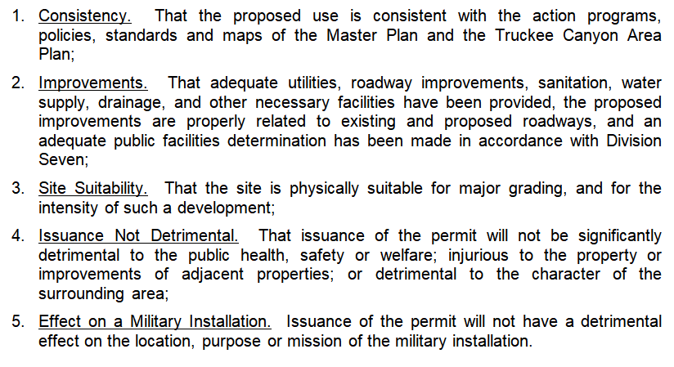
Special Use Permit Findings

Slide 13
Recommendation
Those agencies which reviewed the application recommended conditions to address applicable codes and impacts associated with the project. After a thorough analysis and review, staff recommends that the BOA carefully consider all aspects of Special Use Permit Case Number WSUP19-0019 and the nature of the stringent recommended conditions of approval and approve the requested special use permit.

Slide 14
Possible Motions
APPROVAL: I move that, after giving reasoned consideration to the information contained in the staff report and information received during the public hearing, the Washoe County Board of Adjustment approve with conditions as included as Exhibit A to the Staff Report, Special Use Permit Case Number WSUP19-0019 for Scannell Properties, having made all five findings in accordance with Washoe County Code Section 110.810.30.
DENIAL: I move that, after giving reasoned consideration to the information contained in the staff report and information received during the public hearing, the Washoe County Board of Adjustment deny Special Use Permit Case Number WSUP19-0019 for Scannell Properties, being unable to make all five findings in accordance with Washoe County Code Section 110.810.30.

